Slide 1

Archive Fellowship Progress Report
August - January 2024
Emily Silks (they/them)

Slide 2
This CCWD fellowship built on the archival framework developed in the prior 2024 CCWD internship
1
2
3
Preservation
Collaboration
Presentation
Maintain physical archive and expand accessible online records through digitization
Consult community members to inform our assessment and development of archival projects
Organize collections and expand contextual content based on community feedback

Slide 3
Preservation
1
The GRAMMY Foundation preservation grant is under review to help fund digitization of reel to reels at half of the intended cost

Slide 4
In our preservation efforts, I facilitated the grant writing process to fund the digitization of reel-to-reel tapes
1
Action items:
  Offered solutions for long-term media storage
  Procured digitization estimate from Preserve South, a third party organization
  Resourced community relationships to guide proposal framework
  Crafted writing for LOI & full proposal to the GRAMMY Museum Preservation Grant including the project goals, narrative, and a dissemination plan
  Analyzed data from NWFL archive collection for distribution insights
Preserve South Estimate
Jack Straw Estimate
Estimated Total Cost | $10,169.00
Estimated Total Data | 630 GB
Estimated Turnaround Time | 3 – 4 Months
Estimated Total Cost | $19,500.00
Estimated Total Data | 630 GB
Estimated Turnaround Time | TBD
**Find links to PDF in notes section
Notes:
Grammy Grant LOI:
https://docs.google.com/document/d/1KTKkl_ZgzkDkT9wiRC9rzPGX0lmMHlheDfoNY2ujVWw/edit?tab=t.0
Collections list:
https://docs.google.com/document/d/1S7Wz6Yqb1uI-szRq4TBRCsaBJlq9UnGiMue0_I3AxXI/edit?tab=t.0

Slide 5
Collaboration
2
The NWFL Archive Survey results highlight what matters most to viewers and offer steps for deeper engagement

Slide 6

Northwest Folklife Archive Survey Methods
2
In the fall of 2024, a google survey went out to over 500 artists who have previously performed at the Northwest Folklife festival. Of those contacted, 43 people responded so the findings are only preliminary.
The survey included 12 questions including open ended, Likert scale, and multiple choice. The purpose of this survey was to gather insight into accessibility needs as well as media, content, and engagement preferences of the respondents.

Slide 7
Findings show that there was low awareness about the existence of the NWFL Public Archive
2
Finding | Implication | Next steps
Many respondents were unaware of the archive before the survey. | Even though we advertise it on Instagram, we need a better promotion strategy | Prioritize what channels are best for both advertising and sharing content to boost awareness
Those who were aware of the archive found it hard to use | Limited search options made it difficult to find specific content. | Improved searchability and advanced filters should be prioritized in overall UI Improved categories and visual organization for audio/visual assets are also recommended
“This is the first time I’ve seen it”
“Would be nice to be able to type in a search for performers, country, etc”
“I’d love it to be more readily available, and advertised to the general public”
“I didn’t even know this existed”
“Seems hard to find anything in particular”

Slide 8


Contextuality and representation in the Public Archive are important facets for NWFL community
2
2
Respondents also identified gaps in content, pointing towards the desire for wholistic representation:
“Are more events going to be added for the past six years?”
“I’d like to see much more of community based arts [as opposed to professional entertainers]. Also some representation of traditional crafts, dance, and storytelling.”
More than half of the respondents want to see more contextual details about community artists and performances
“Include more genres! Definitely reggae. Perhaps ska too.”
“There isn’t much video or audio for dance, and most of the audio is quite old.”

Slide 9
Improving accessibility will not only make the archive more inclusive but also increase its usability and reach
2
Finding
In addition, other concerns that came up multiple times include screen reader compatibility and better indexing
Next Steps
Explore strategies to effectively implement captioning in our database – especially in the potential for using AI as a tool?
Of 27 un-aided responses, nearly half mentioned the desire for translations and subtitles, indicating a strong need for multilingual accessibility
Develop better metadata tagging and filtering tools to improve content discoverability

Slide 10
People want to engage more with the Public Archive but UI barriers prevent participation
2
2
98% of participants are open to contributing to the Public Archive in some way
More than 80% of respondents want the archival materials to be sharable to other websites and social media platforms
Next Steps:
Develop structured ways to submit photos or audio recordings from the Northwest Folklife Festival. **We must clear guidelines and have method to screen for QC**
Prioritize features that enable content sharing for archival materials
Test and refine engagement strategies by continuing to gather feedback and improve accordingly

Slide 11
Presentation
3
Significant redesigns to the Public Archive database have helped to arrange and curate archival materials for general accessibility

Slide 12
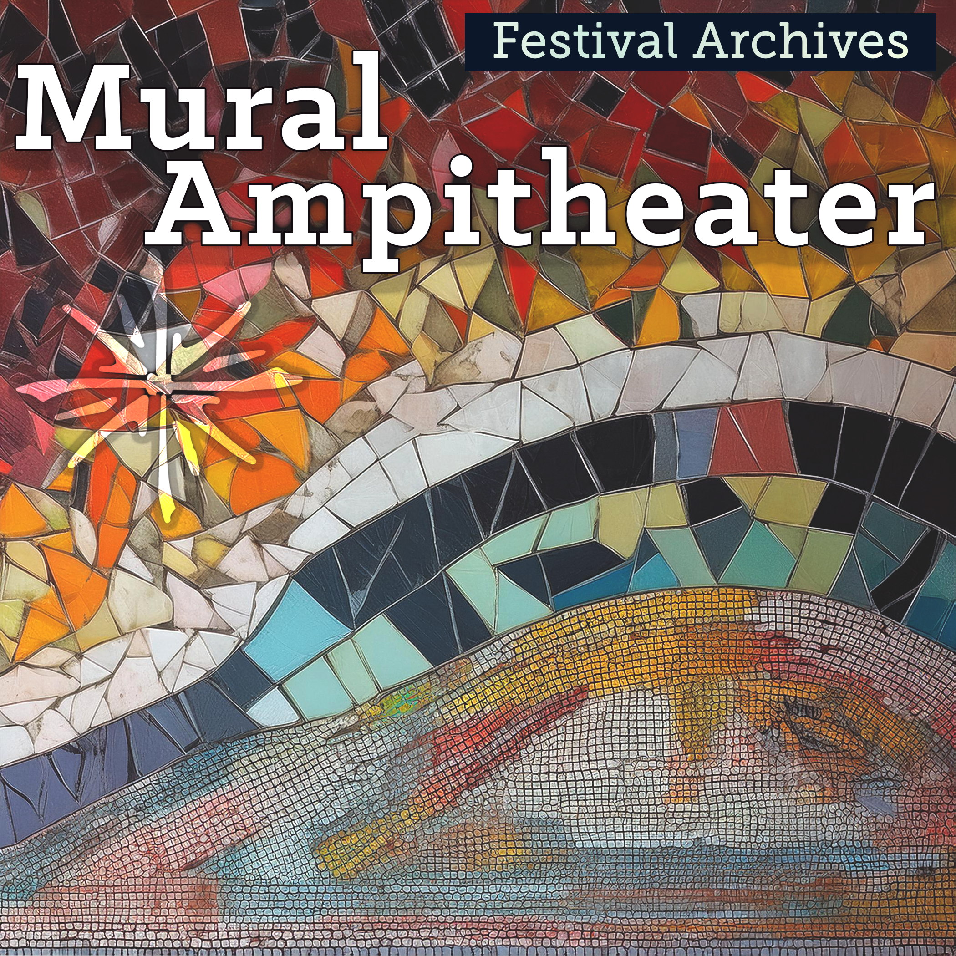

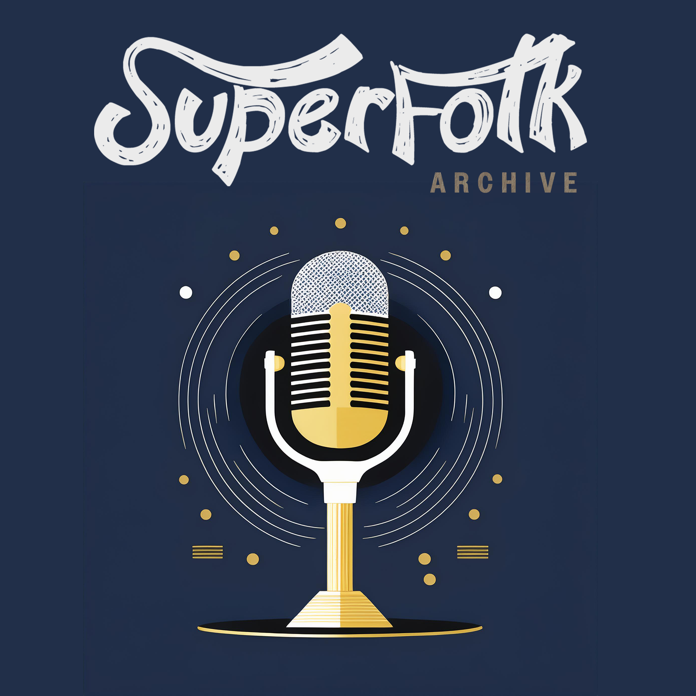



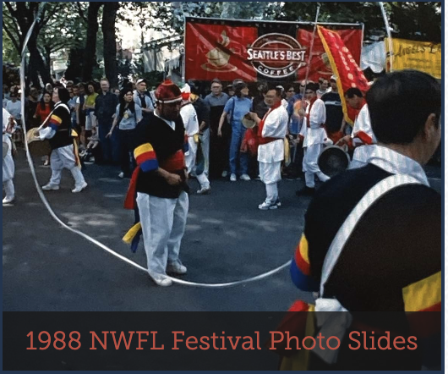
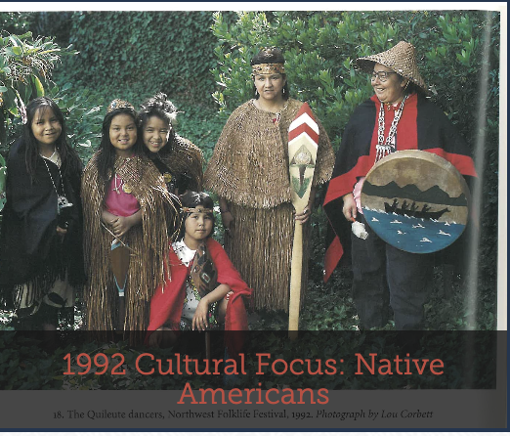
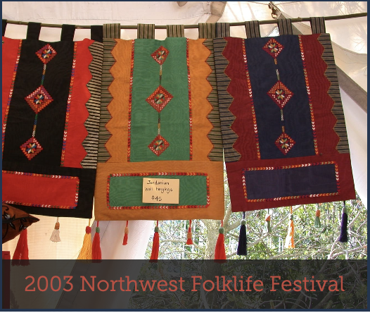
Adjustments made to NWFL’s Public Archive presentation allows viewers to more easily navigate our database*
3
Redesigned video icons match updated category filters based on program and performance venue
Redesigned audio icons match updated category filters based on geographical region
Image galleries feature highlights from entire festival years or cultural focus

Slide 13
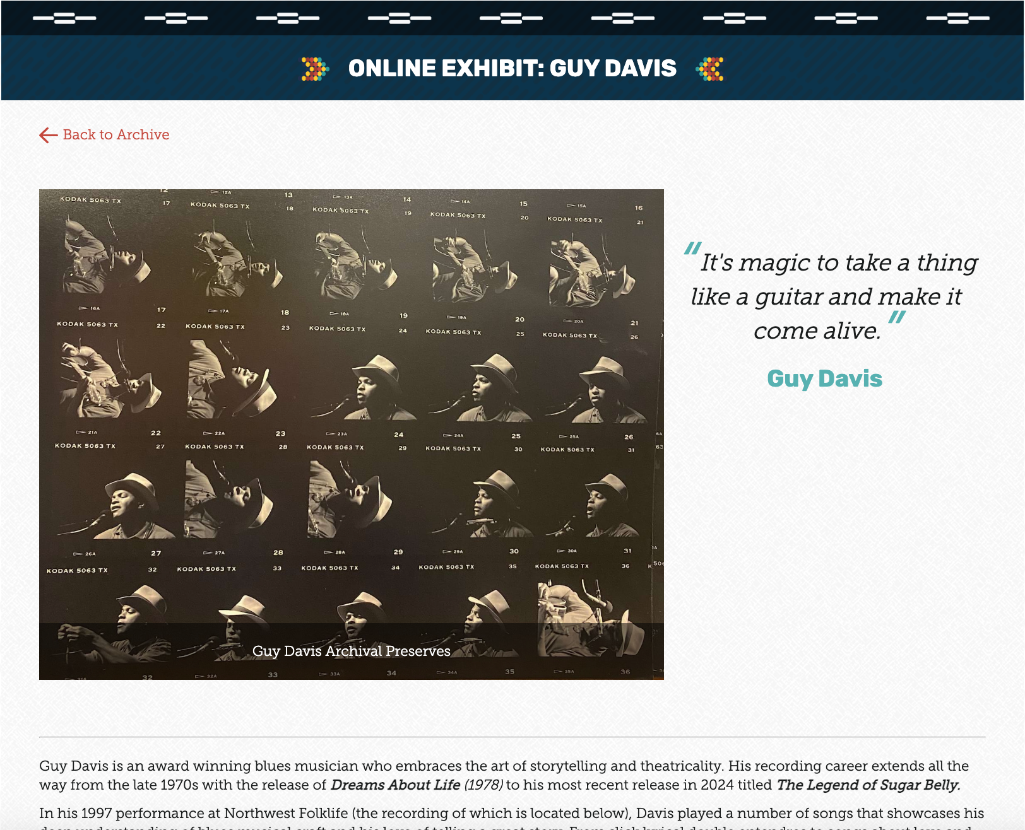
Presenting long form archival content offers more context and resources to viewers, listeners, and artists themselves
3
The launch of Online Exhibits features:
Full page website design
Artist biographies backed by reputable sources
Review and description of a highlighted NWFL performance recording
Audio and visual media for further viewing
Links to further resources
Expanded context for audio and video databases include:
Brief artist biographies
Links to artist’s social media, if applicable
Track listing of NWFL performance recording

Slide 14
Thank you!
Emily Silks (they/them)
mlesilks@gmail.com
@mlesilks

Slide 15
Appendix Slides
The following slides include additional statistics from the NWFL Archive Survey

Slide 16
NWFL Archive Survey revealed demographic insights into self-identification
3

Slide 17
NWFL Archive Survey demographic insights
3

Slide 18
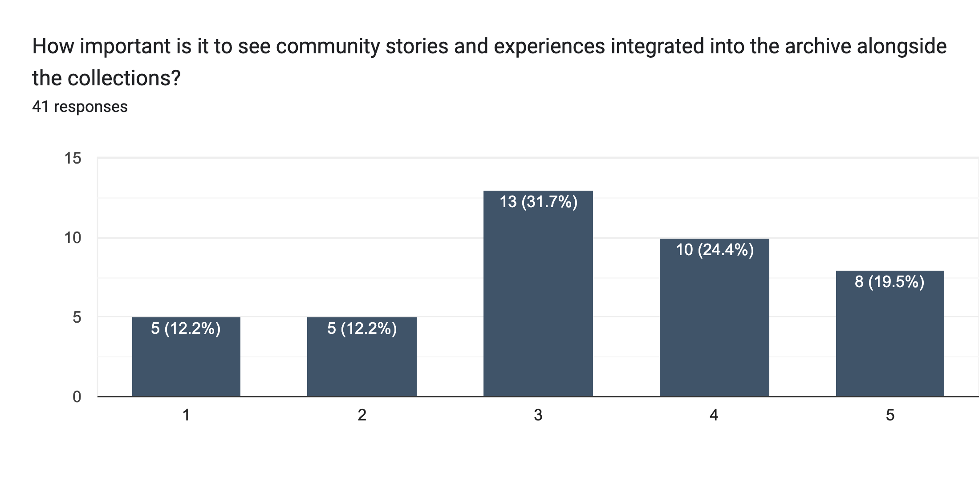
NWFL Archive Survey data insights
3
Viewing Preference

Slide 19
NWFL Archive Survey data insights
3

Slide 20
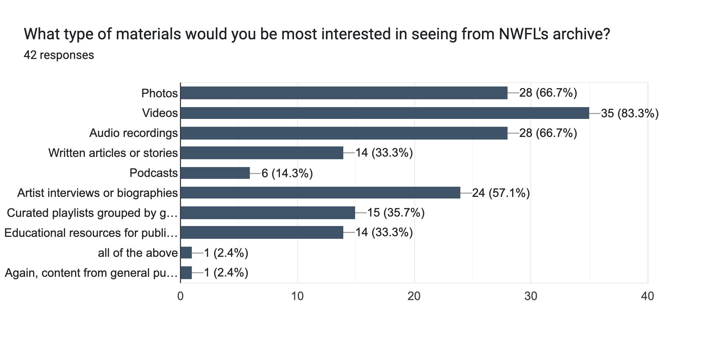
NWFL Archive Survey data insights
3

Slide 21
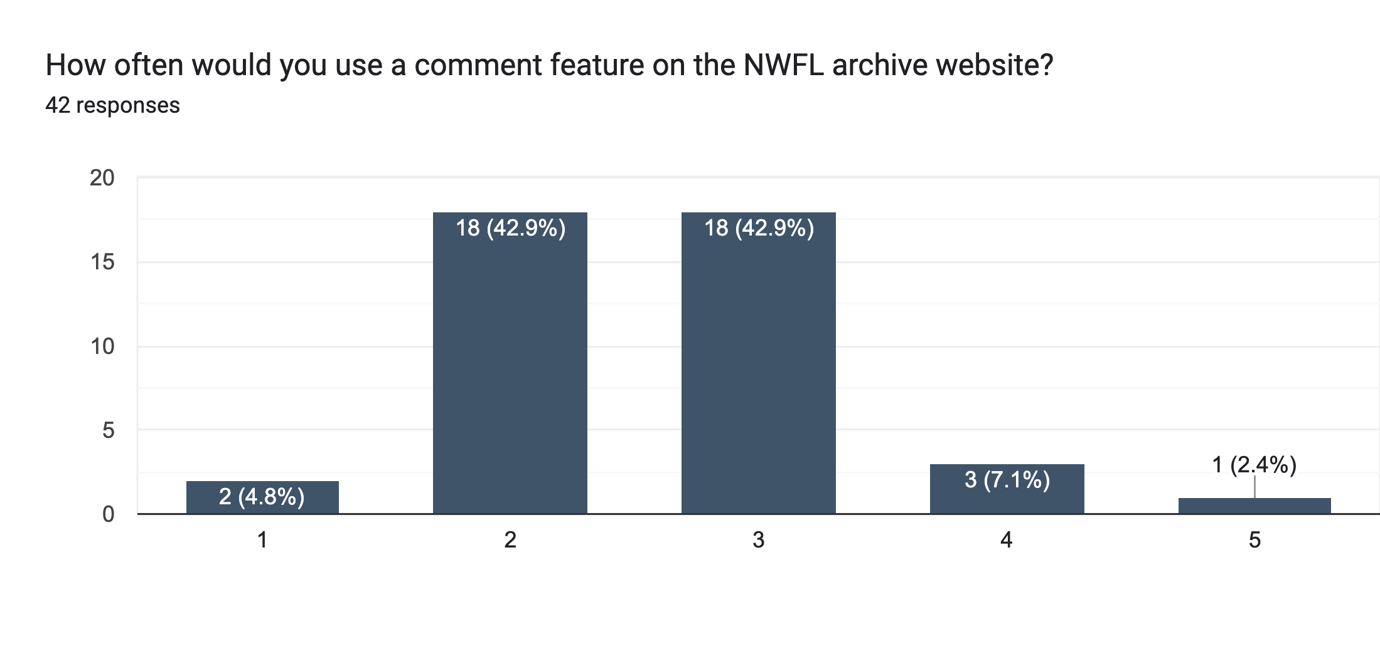
NWFL Archive Survey data insights
3

Slide 22
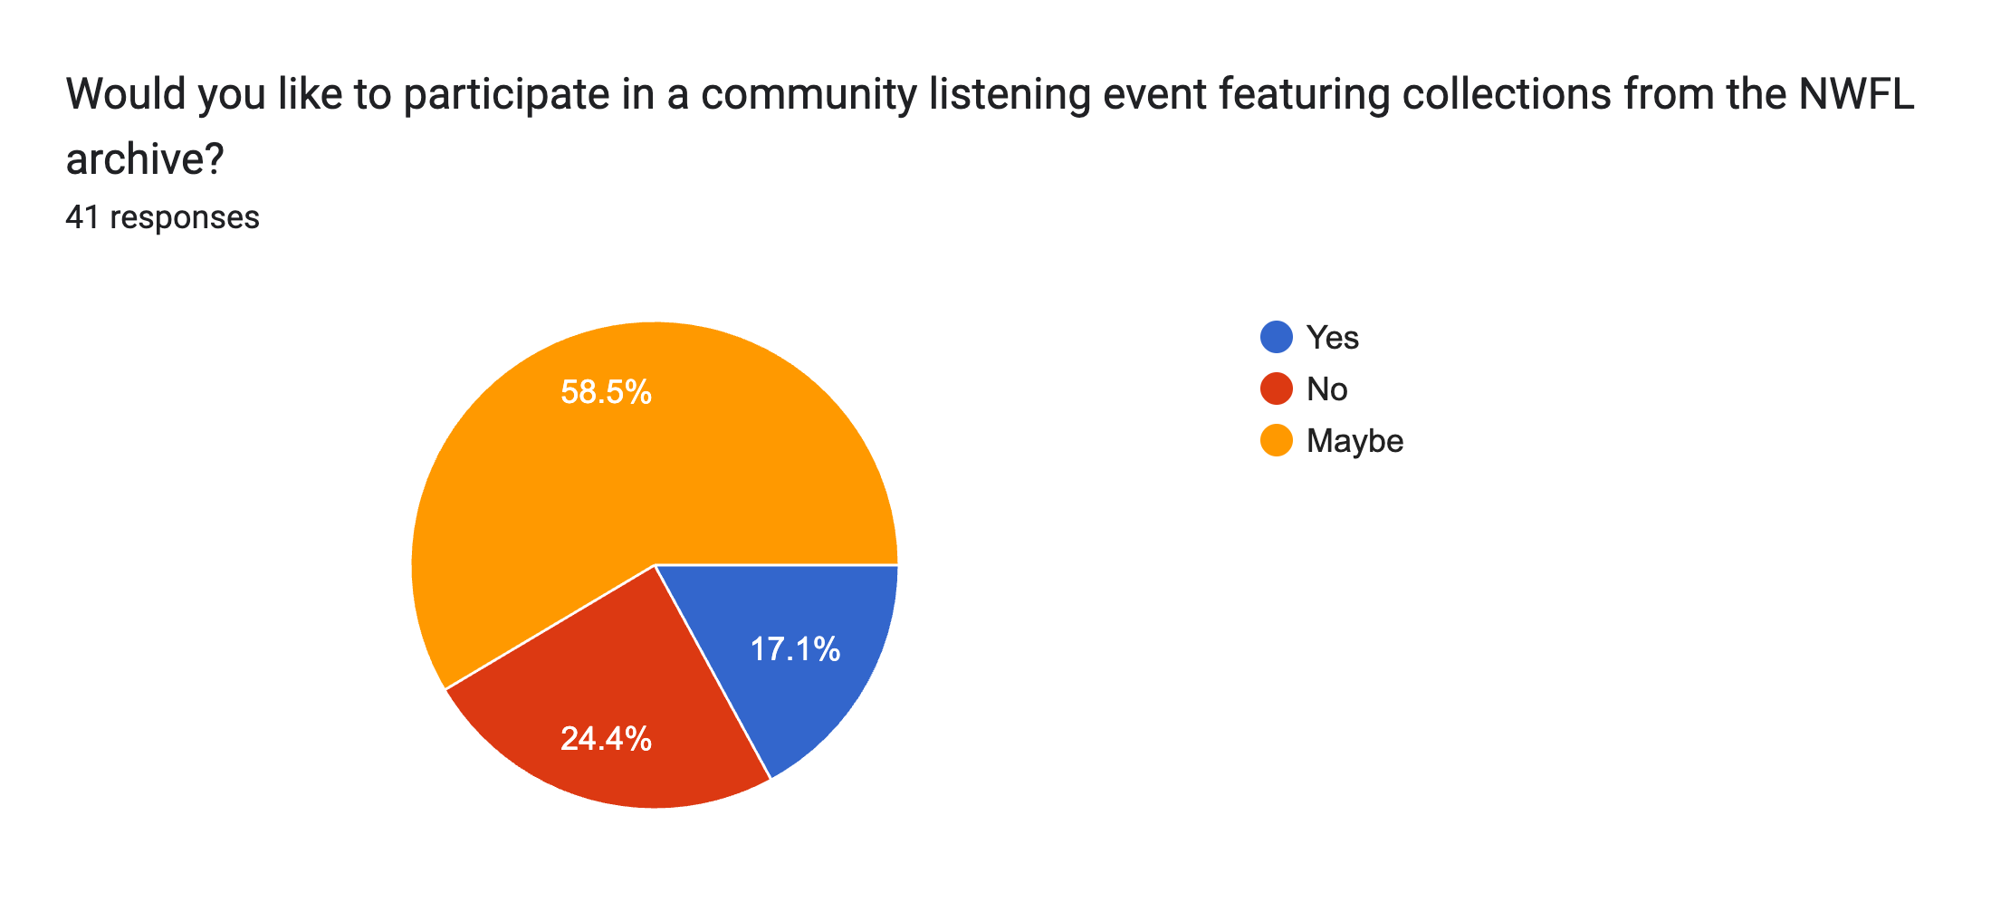
NWFL Archive Survey data insights
3

